Slide 1
State of the Affiliate Industry
2022 Advertiser & Agency Study
Notes:
Hello everyone, today we’re going to release the top level findings from 2022’s advertiser and agency study – a join initiative between a number of leading affiliate companies designed to give you a snapshot about the health of the UK affiliate and partner marketing industry.

Slide 2
Introducing your speakers
Kevin Edwards
Global Strategy Director
Awin
Anthony Clements
Managing Partner
Adtraction
Linda O’Connell
Snr. VP, UK & Ireland
CJ

Slide 3
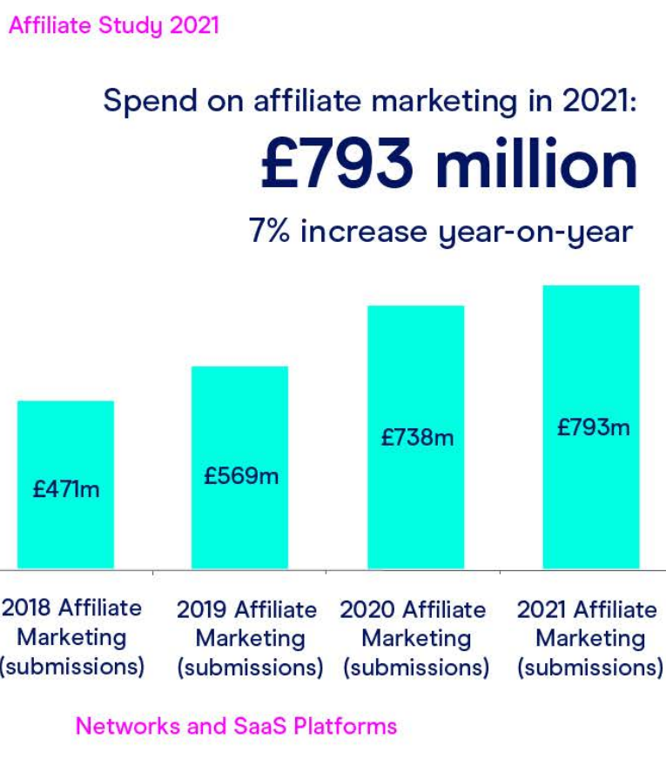
First, some context on the UK industry…
UK affiliate spend up 40% in two years
Spend is limited to seven affiliate businesses: doesn’t scope whole industry
Notes:
First a bit of context.
You may have seen this statistic from earlier in the year.
As part of the IAB’s adspend survey in conjunction with PwC, they attempt to provide a snapshot of the size of the UK industry.
The headline figure from April is that the industry has continued to grow, up 7% YoY, and up 40% over two years – illustrating just how resilient the channel was during the pandemic, the reverse of what was seen elsewhere.
Unfortunately they only take the data that is submitted which means a very sizeable chunk of the industry is not captured – anything from agencies not tracked through the seven submitting companies, to major programmes like eBay’s and Amazon’s won’t feature here. So while the growth is great to see, this is a very conservative and partial view of the UK industry.
Also this number in isolation is great for showing it’s a channel brands are continuing to invest in, but it doesn’t get below the skin of what’s happening at a more granular level.

Slide 4
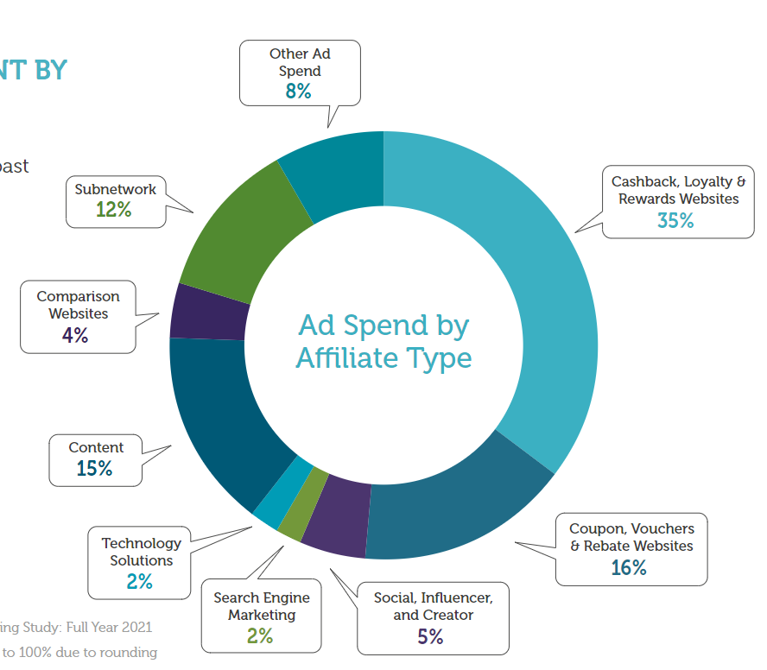
…and from the other side of the pond
US affiliate spend topped $9.1bn in 2021; an increase of almost 50% since the previous survey in 2018
US advertiser revenue of $71bn averaged to an ROI of 12:1 (retail only)
Notes:
Now about ten years ago we embarked on an ambitious project to provide that context for the UK market and it was fantastically powerful piece of work that – for the first time anywhere – showed the power of the channel.
And while we no longer have that in the UK, I’m pleased to say a few years back the US took up the mantle and emulated that work with their first qualitative and quantitative survey.
While COVID derailed last year’s survey, I’m pleased to say that the Performance Marketing Association in the US released – a couple of months back – the latest size of industry survey. Including submitted and modelled data it also sought to shine a light on the ROI across sectors as well as publisher trends.
$9.1bn spent on affiliate and partner marketing represents growth of almost 50% since the previous survey and an overall ROI figure of 12 dollars earned for every dollar spent.
Incidentally I know 71 divided by 9 doesn’t equal 12, but the ROI figure only took into account revenue that could be measured which it can’t be for all sectors.

Slide 5
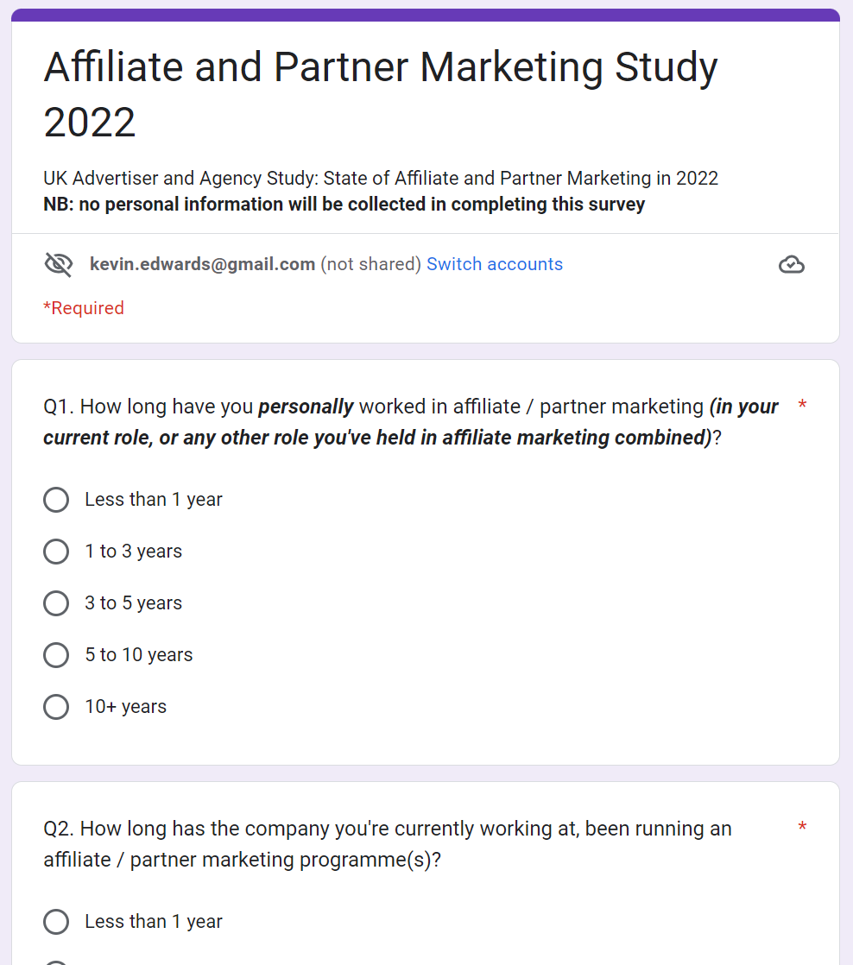
Introducing a new Advertiser & Agency Study for 2022
Industry collaboration
Supported and promoted by eight businesses
Qualitative data
To back up the IAB quantitative data from April 2022
Open to everyone
Agencies and advertisers of all sizes responded: 137 in total
Notes:
Onto this year’s study then.
Awin, CJ, Impact, adtraction, Tradedoubler, Acceleration Partners, Optimise and Rakuten pooled resources to create a survey of 21 questions and asked advertisers and agencies to complete it across two weeks in September.
It was open to anyone who fitted that criteria and 137 completed it.
The questions dealt with a range of topics and areas of interest and now we’re going to cover off some of the top insights we gleaned.
It’s not exhaustive and we won’t have time to cover everything, but we hope to publish the fuller findings in due course.

Slide 6
A cross-industry collaborative effort
Notes:
Thanks to the following companies for advising on the content of the survey and distributing it to their networks.
If you work with any of these companies and would like further information please reach out to your representative in the next couple of weeks when we hope to have a full write up of all the findings.

Slide 7
So, what were the results?

Slide 8
Is the current business you work for…
76%
An advertiser / retailer
24%
An agency

Slide 9
How long has the company you're currently working at, been running an affiliate / partner marketing programme(s)?
Half of companies have been running programmes for more than five years

Slide 10
What best describes your business? (please only answer if you're an advertiser / retailer / merchant /brand)

Slide 11
How best describes your affiliate or partner programme? (please only answer if you're an advertiser / retailer / merchant /brand)

Slide 12
Which of the following industry sectors does your company / agency operate in? (please select all that apply)
*Note: respondents could select more than one sector. Agencies typically represent customers across multiple sectors which is why the totals add up to more than 100%

Slide 13
Which markets do you run an affiliate programme in? (please select all that apply)
*Note: respondents could select more than one market.

Slide 14
Which payment models are you or your clients using to do affiliate and partner marketing? Please select all that apply.
*Note: respondents could select more than one payment model.

Slide 15
Compared to other marketing channels you use, are you looking to spend a higher proportion of your marketing budget on affiliate and partner marketing over the next year?
15x more are increasing rather than decreasing
The larger the spend, the more likely brands are to increase their budgets
No agencies said they were planning on reducing their budgets
Notes:
So a natural place to start is: Compared to…
Well the positive stat is that almost half of respondents intend to spend more on affiliate marketing over the coming year.
In fact 15x more than plan to decrease spend.
When we cross referenced the data against size of advertiser we found the larger the programme, the higher the percentage of those intending to increase their budgets, perhaps an indication that these campaigns tend to be more mature and as such perhaps there’s clearer strategic focus as well greater confidence in knowing that that extra investment will lead to more sales at this difficult time.
No agency said they planned to cut their affiliate spend.

Slide 16
On average how much do you spend on affiliate or partner marketing each month? (Includes all fees, commissions, etc.)
Almost 1 in 3 spending at least £600k per year
7% spend more than £10m a year
Notes:
So far so good, but how much are people spending?
This graph shows on average the total spend on commissions and fees that brands and agencies spend on their affiliate campaigns.
The three bars in purple show that about one in three respondents spend more than £600k per year on their affiliate campaigns, with one in 14 spending more than £10m per year.

Slide 17
What percentage of your revenue is generated by the affiliate / partner marketing channel?
Affiliate accounts for more than 10% of revenue for almost 2/3
More than half of the 31% spending more than £600k see in excess of 20% of their sales through affiliate
US PMA study digital marketing is 3.5% of total digital spend; revenue is 10%. Affiliate represents bang for your buck
Notes:
Breaking that down further, a critical statistic is how much impact the affiliate channel has on a brand or agency’s overall sales.
As someone who’s been to many sales pitches, when asked, we typically quote the magic 15% number – that is, a well optimised affiliate campaign could account for around one in six of your online sales.
The data from our survey showed that for more than two thirds of the respondents, the channel generates more than one in ten of their online sales, and that for more of than half of the bigger spending advertisers and agencies who responded, that rises to more than one in five.
There is obvious variance within that depending on the maturity of the campaign, the openness to work flexibly and the sector they operate in.
If we dial back to the data I showed you from the US study, What is particularly of note to me is that the 71bn dollars attributable to the channel represents 10% of all ecommerce in the US, whereas the 9bn in commissions and fees is just 3.5% of all digital marketing spend.
It proves what we know – the channel is a heavy lifter, punching above its weight.
The challenge is to ensure our share of basket equals our share of voice – that requires ongoing encouragement of brands to continue their investment so affiliate marketing grows in importance overall.

Slide 18
Compared to a year ago, do you think there are more or less affiliate partnership opportunities in the affiliate and partnership channel?
Almost 50% feel there are more
1 in 3 see no change
Most are optimistic but the perception is more opportunities are needed
Notes:
Missing % number of purple pie chart

Slide 19
Recent diversity a result of accelerated publisher growth?*
Amazon commission cuts
Covid lockdowns start
*Awin & ShareAsale data. But indicative of wider trends seen across other affiliate platforms over the same period.
Notes:
We think there are two reason for that – one we saw an uptick in people looking to supplement their incomes with affiliate commissions, plus Amazon chose to slash many of their commission groups which was a massive boon to competing affiliate programmes as a big linking switching push was initiated by advertisers helped by networks like ours.
Linda – can concur and state we see the same trend but more diverse types of publishers, some of largely driven by the pandemic

Slide 20
On a scale of one to ten, how valuable are the following affiliate models, with ten being most valuable and one being least valuable?*
Most of the models to the right of the line are newer and are more strategic, one to one partnerships. We felt concluded that a lack of adoption my advertisers may account for their lower scores, rather than this being a comment on their value.
*Note: all respondents rated ten affiliate models on a scale of one to ten, no respondent could grade the same affiliate the same score. Affiliate models were compared against each other, not against other digital channels.
Notes:
Remember these are relative to each other – so not how important do you consider them in the grand scheme of things or against other channels, more how do they stack up against each other
Pubs to left represent longer standing, large advertiser base affiliates.
They are more ubiquitous and typically reliant sales drivers.
Most of the categories to the right of the dotted line are newer or require more nuanced and in depth discussion.
We know media houses – traditional publishing houses – are experiencing significant growth in the channel. Businesses like Wirecutter and Buzzfed or Future and Hearst. They are almost neck and neck with the powerhouses of the voucher world.
For influencers we have that inevitable conversation about moulding them to the affiliate channel when typicaly they would have sat outside it.
Brands building their own affiliate brand partnerships is another rapid growth area, as are the tech solutions but both are slower burn, strategic partnerships that don’t currently have the mass cut through of cashback or price comparison.
It will be interesting to monitor this one over the coming years.

Slide 21
If you could choose 3 affiliate models to grow your revenue with over the next year, which would you choose?
*Note: all respondents were asked to pick from three affiliate models from ten affiliate options without scoring the three in order of preference.
Notes:
Remember these are relative to each other – so not how important do you consider them in the grand scheme of things.
In a way this next slide does ask for what a future publisher mix looks like as it asks which ones brands want to invest in more.
Well over half want to invest in content and editorial, significantly above the next category of influencer.

Slide 22
Compared to other digital marketing channels that you work with, which of these statements best describes your feelings about affiliate / partnership tracking

Slide 23
Compared to other marketing activities, how do you rate affiliate or partner marketing for achieving the following marketing results? (Score out of 5)

Slide 24
How important are the following success metrics when assessing Affiliate Marketing? (Score out of 5)
*Note: all respondents rated these metrics within the context of the affiliate channel and not within the broader context of other digital marketing activity.

Slide 25
What if, anything, prevents you from investing more in the affiliate and partnership channel?
Lack of publisher diversity
Unpredictability / difficult to budget
People don't understand it in my business
Notes:
1. 43 respondents
2. 42
3. 34
Lack of Pub Diversity – perhaps we can lean on how brands say they want to diversify but to work with some pub models, they need to become more agile in how they measure success or ROI like for Influencers require more than a cpa and it’s a gradual life cycle building upon each campaign. . Similar for brand to brand – it's a different way of working than your cashback/voucher pubs so needs a mind shift of how brands measure ROI and profitability.
Unpredictability/difficult to budget – change in mindset needed to work with affiliate as it’s a guaranteed sale/outcome compared to other marketing channels with fixed budgets. Need to consider the measurement
People don’t understand it in my business – this completely highlights the need for more education higher up in the brand’s businesses for affiliate/performance marketing. Could also related to Q.8. re spend amounts by month – a large portion of large businesses (Q.4) spend £5k-£50K a month....why not more? Due to lack of understanding by the budget holders.

Slide 26
Key themes that emerged in the survey feedback
Publisher diversity/ Building relationships
Education / Training
Awareness
Too expensive
Incrementality
Tenancies
Network standards
Trust & transparency
Cookie technology
Notes:
Here I’ve grouped some themes from the free text field.
We have around 60 comments and we don’t have time to feature them all so we’ve loosely grouped them according to the most commented on.
Firstly, what came through loud and clear is that brands and agencies want more affiliates, but it’s not necessarily they don’t have access to them, it’s more that they struggle to curate them or find the ones that are most relevant. A note to networks and other suppliers: finding easier ways to facilitate this could be worth its weight in gold.
Second, the theme of training, education and general awareness was stressed, from an individual company point of view, from people saying they need help educating their teams to the grassroots exposure in university courses.
A warning shot here for networks and their pricing, that costs were too high for some brands to effectively manage all their affiliate relationships – in particular the rising cost of tenancies that both diluted the performance model and made it difficult for smaller businesses to compete.
We’ve lumped these three topics, demonstrating the value of the network through proving the worth of the sales, while ensuring standards and fundamentals like tracking are in place. All fundamental structural topics that require considerable resource and investment.
And final, the more trust and transparency brands have, the more they will invest. Networks and suppliers need to present a confident and fully open approach to working with their customers.

Slide 27
Tough times for marketers in today’s macro-economic climate…

Slide 28
Recent IMRG survey paints a confusing picture
Notes:
That pretty healthy headline stat comes against a backdrop of huge economic certainty.
Fresh of the press is this IMRG survey – they asked their advertiser members what actions they plan to take in light of the cost of living crisis and these three stats, through an affiliate lens, provide a confusing picture. We know that some of the most successful affiliate models will help deliver value for consumers, but brands are under pressure to make internal savings.
The challenge we all have

Slide 29
But UK advertisers and agencies are bullish on the affiliate channel’s value…

Slide 30
In light of the current concerns about the increase in the cost of living, do you think the affiliate and partner marketing channel will be more or less important in helping you to achieve your marketing goals?
68%
More important
4% Less important
Notes:
This survey is

Slide 31
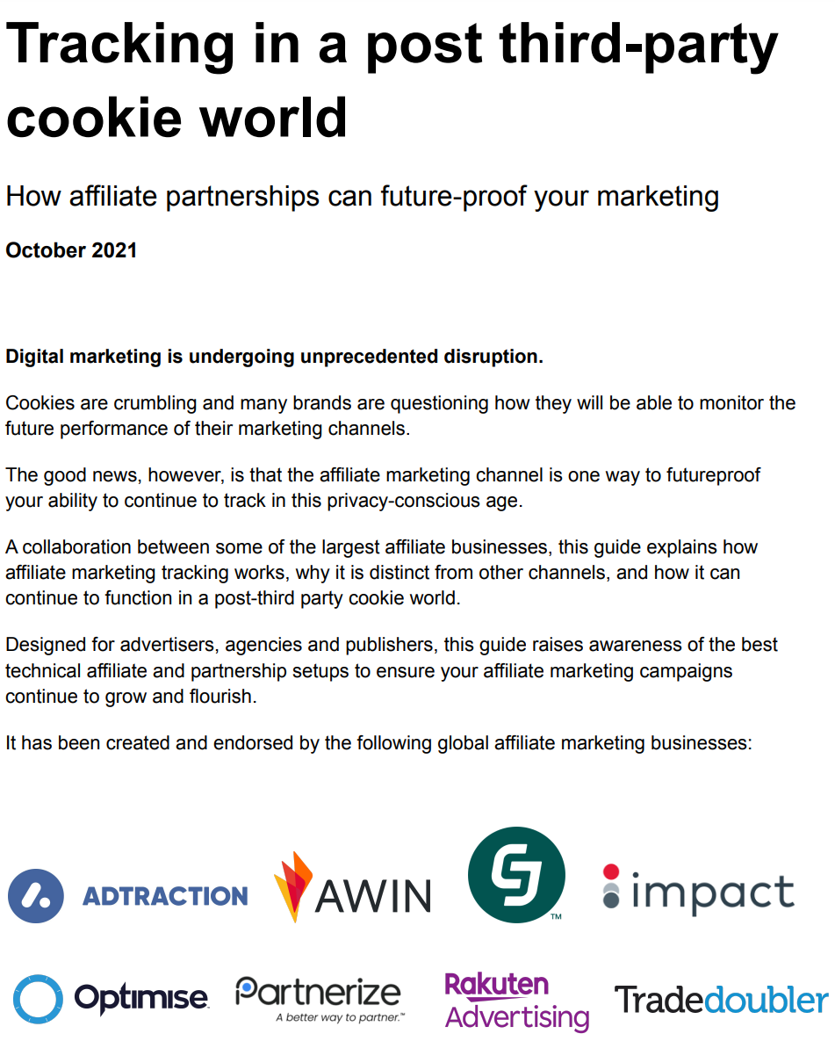
Collaborative industry approach
51%
42%
35%
21%
https://www.affiliatepartnertracking.com/
Notes:
Incidentally as part of an initiative that came about from last year’s affiliate study that found that half of surveyed advertisers believed they were reliant on third party cookies to track activity, we led a collaborative tracking education piece released last year that you may want to check out if you’re faced with the task of selling in a tracking upgrade to your business.
The URL is affiliatepartnertracking.com and you can access the short guide for free.

Slide 32
State of the Affiliate Industry
2022 Advertiser & Agency Study

